Slide 1
Unit 5 - Exploring bivariate numerical data

Slide 2
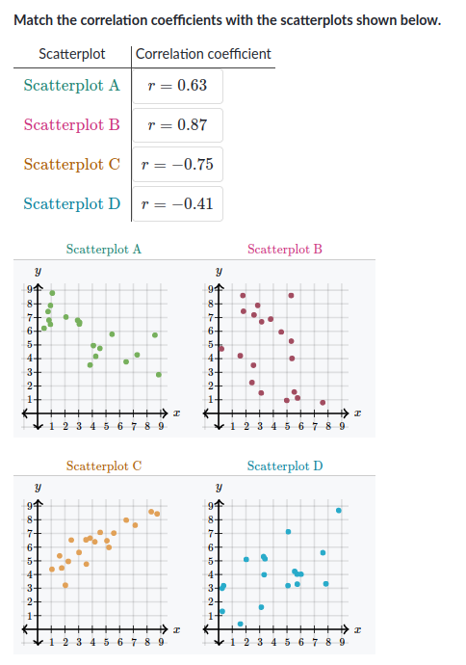
Q1 - Correlation coefficient (r)

Slide 3
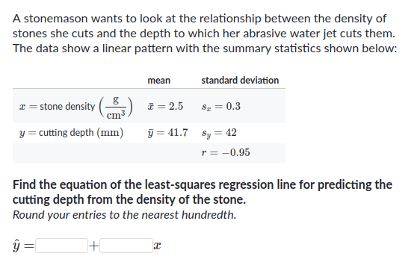
Question 2: Least squares regression line
Slope (m) = (Sy / Sx) * r
y = mx + b
You will compute b using the mean values given to you.

Slide 4
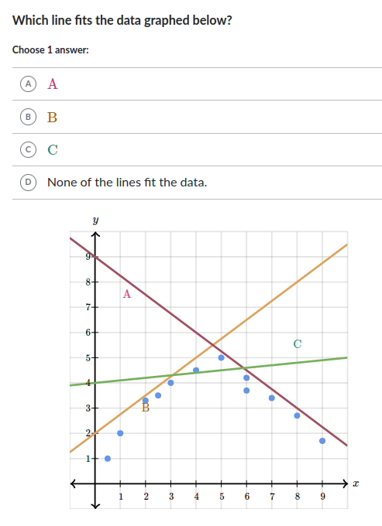
Q3 - Scatter plot and line of best fit

Slide 5
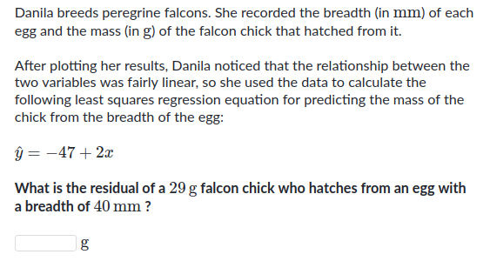
Q4 - residual

Slide 6
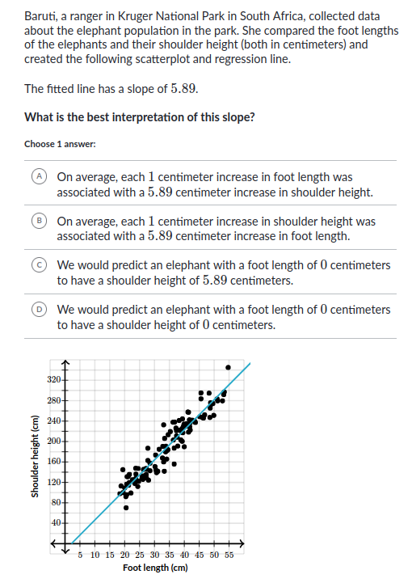
Question 5: Interpretation of slope

Slide 7
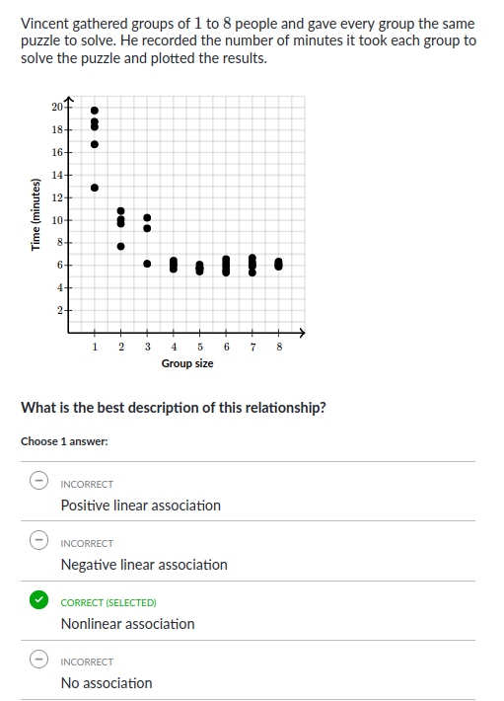
Question 6: Non linear association

Slide 8
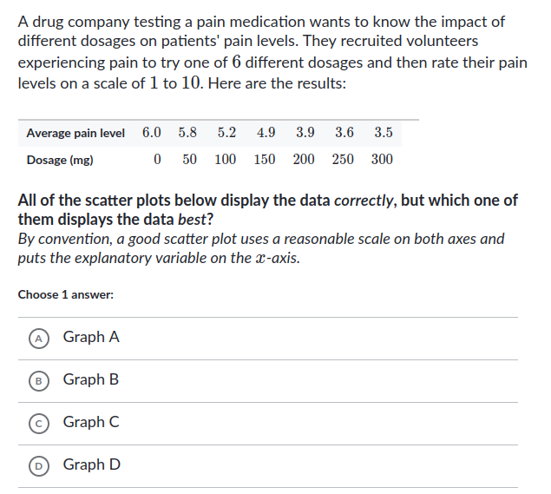
Q7: Scatter plot construction
PTO for graphs

Slide 9
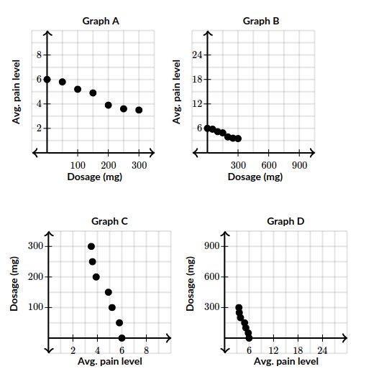

Slide 10
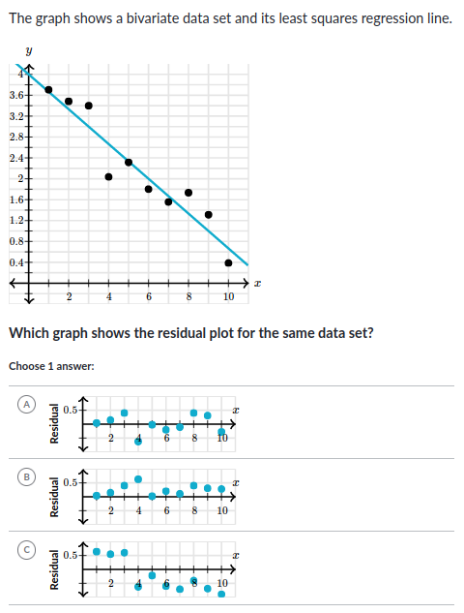
Q8 - Residuals from line of regression

Slide 11
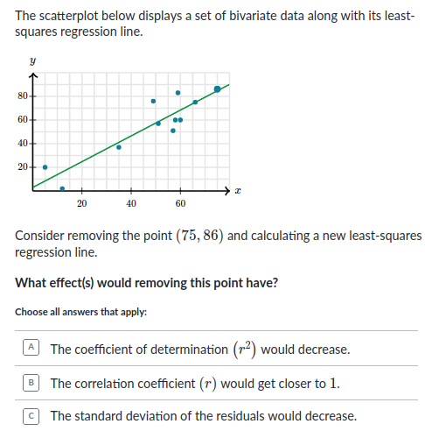
Q9 - Coefficient of determination

Slide 12
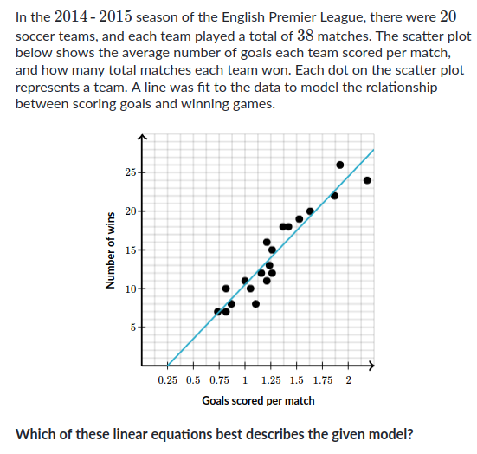
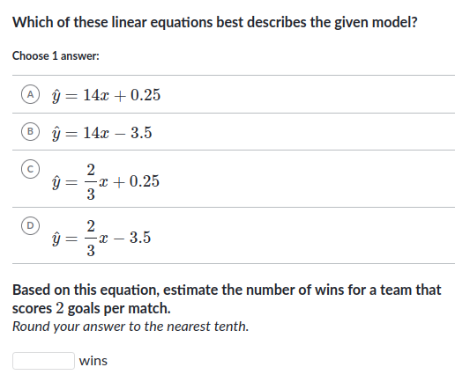
Q10 - Interpretation of scatter plot for equation of line of regression

Slide 13
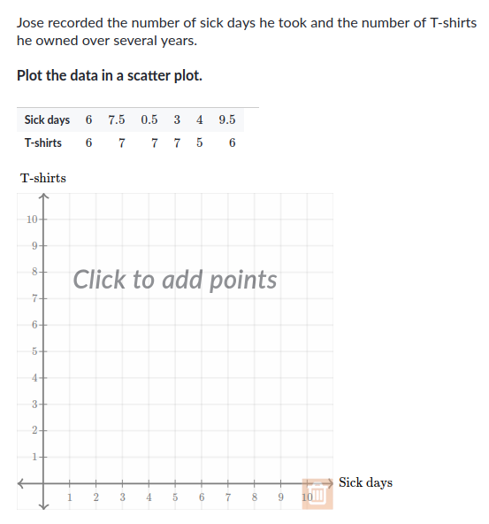
Q11 – Scatter plot building

Slide 14
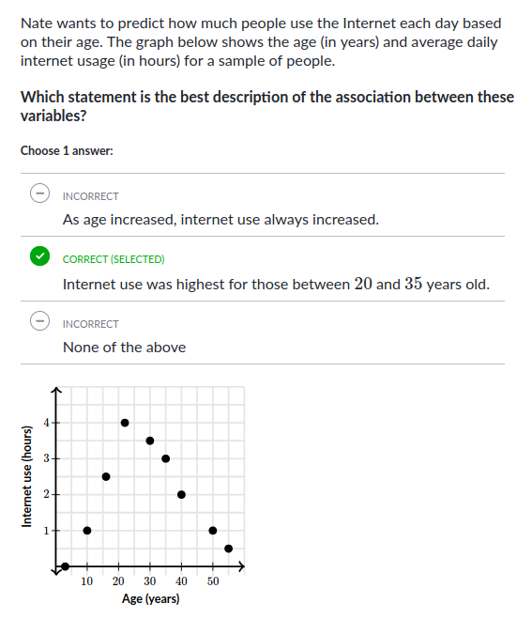
Q12 - Identifying the association from scatter plot

